Slide 1
Crack case

Slide 2


This is Bobby.

Slide 3

And this is Sophia.

Slide 4
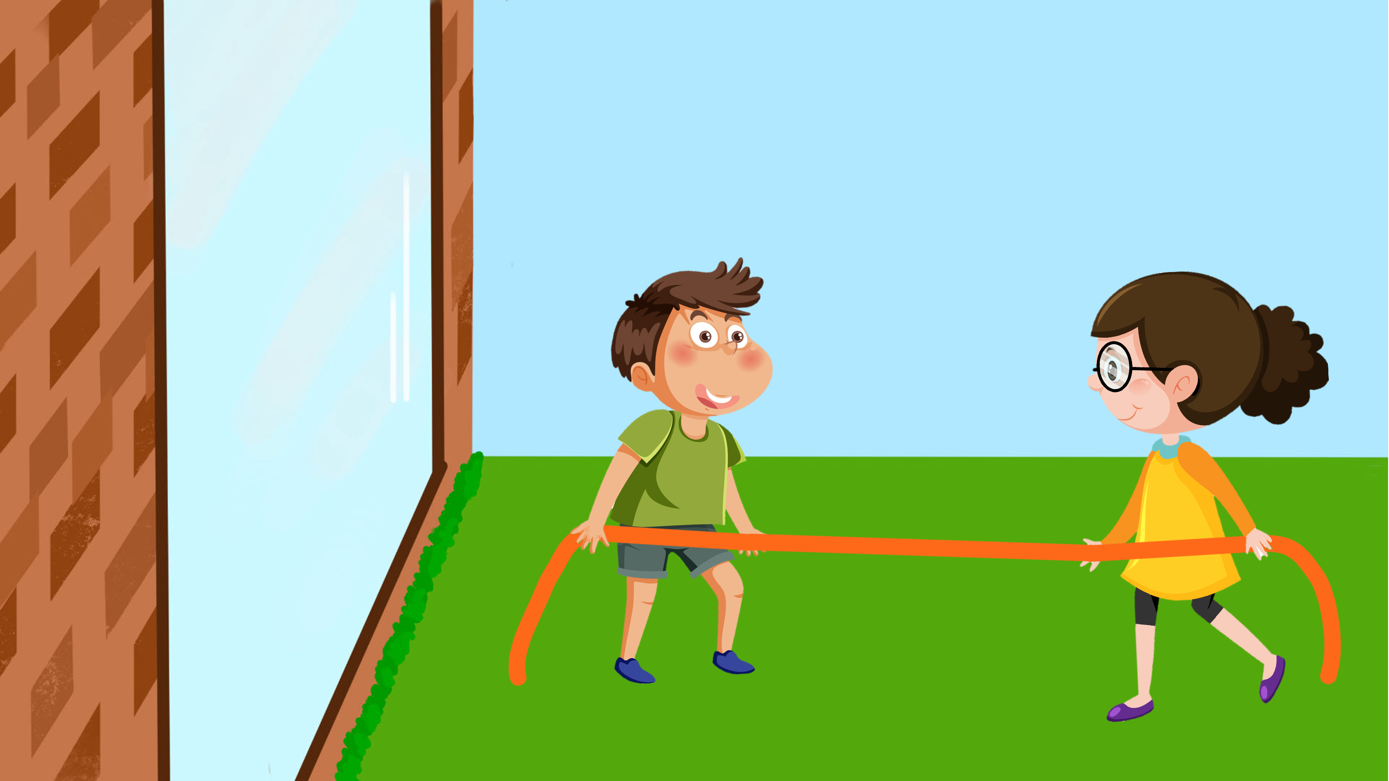
Bobby and Sophia are playing tug of war in the yard outside their house.

Slide 5
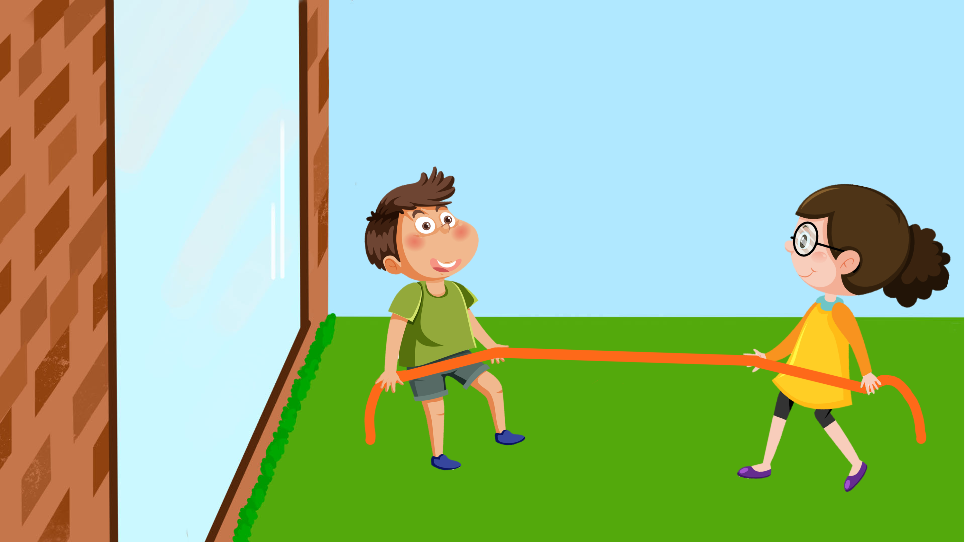
Both of them are pulling really hard on the rope.

Slide 6

While Bobby is pulling, Sophia suddenly lets go of the rope!

Slide 7
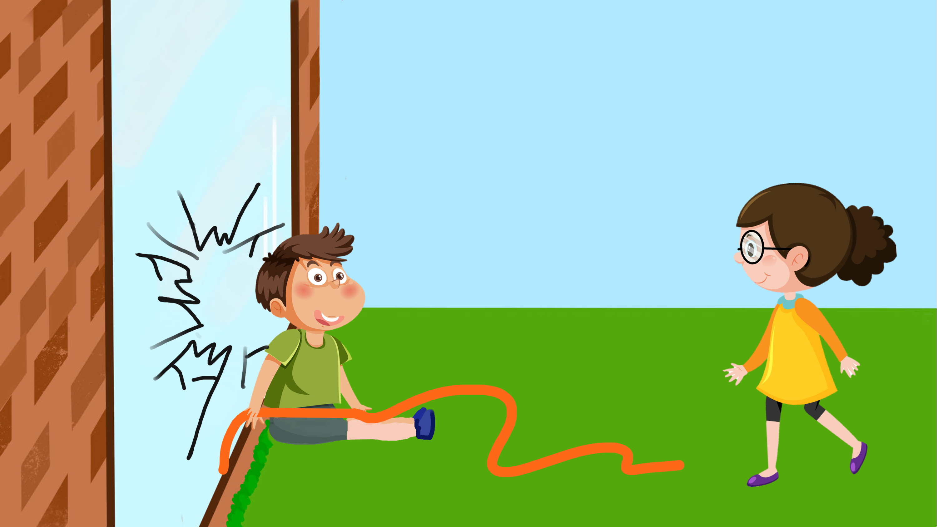
Bobby falls into the window, and it cracks.

Slide 8

Luckily, nobody got hurt – Bobby was OK.

Slide 9
Now that you saw what happened we would like to ask you a couple of questions.

Slide 10
Who cracked the window?

Slide 11
Who caused the window to crack?

Slide 12
Whose fault is it that the window cracked?

Slide 13
Break case

Slide 14

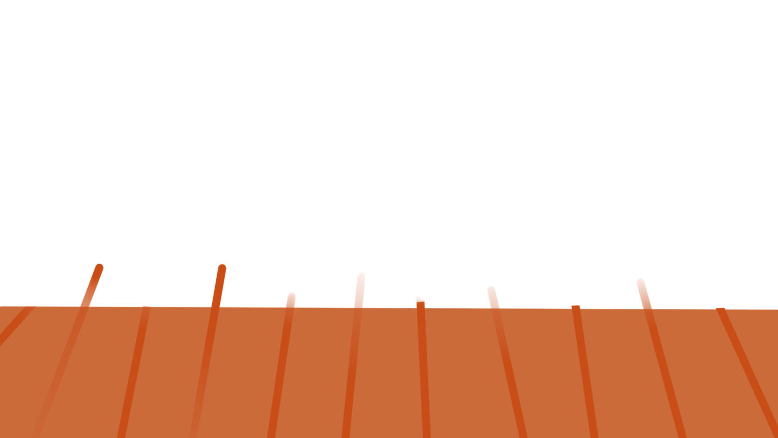


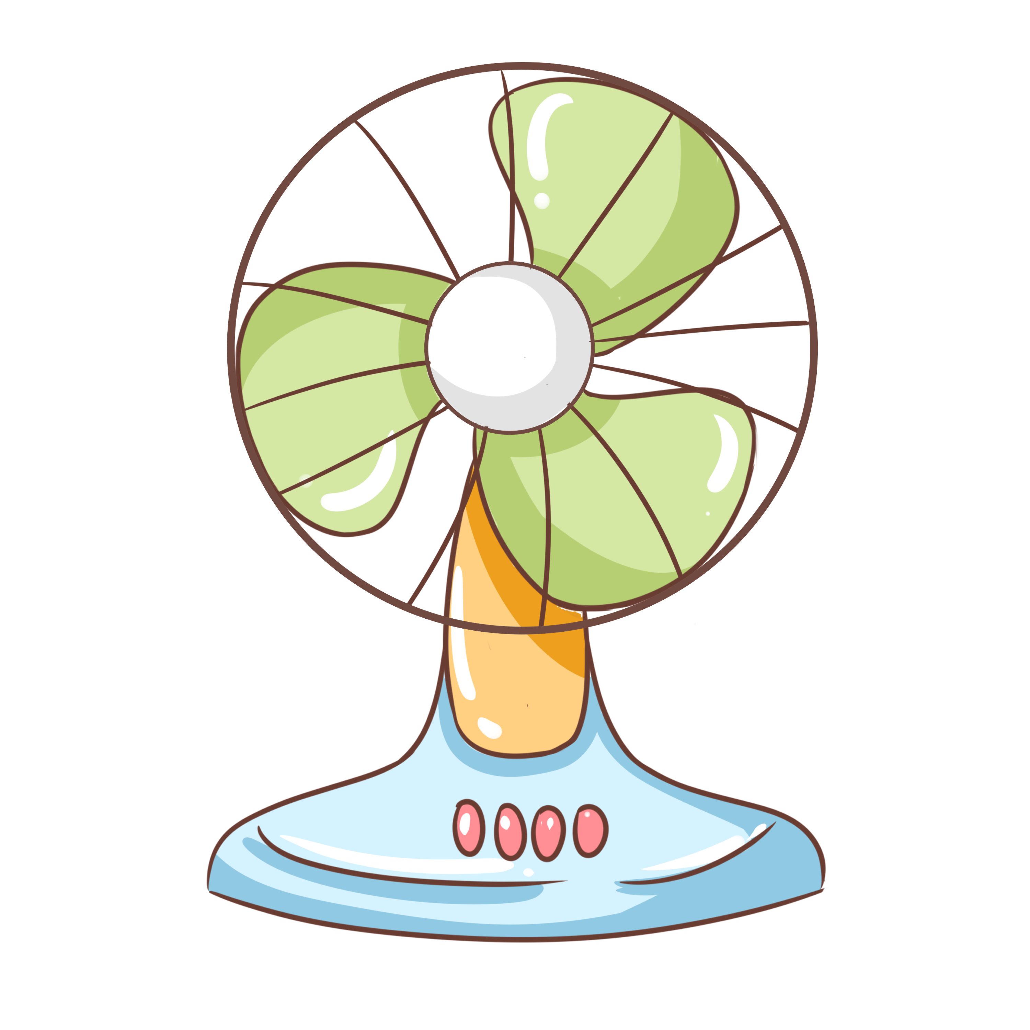
This is Andy.

Slide 15
And this is Suzy.

Slide 16
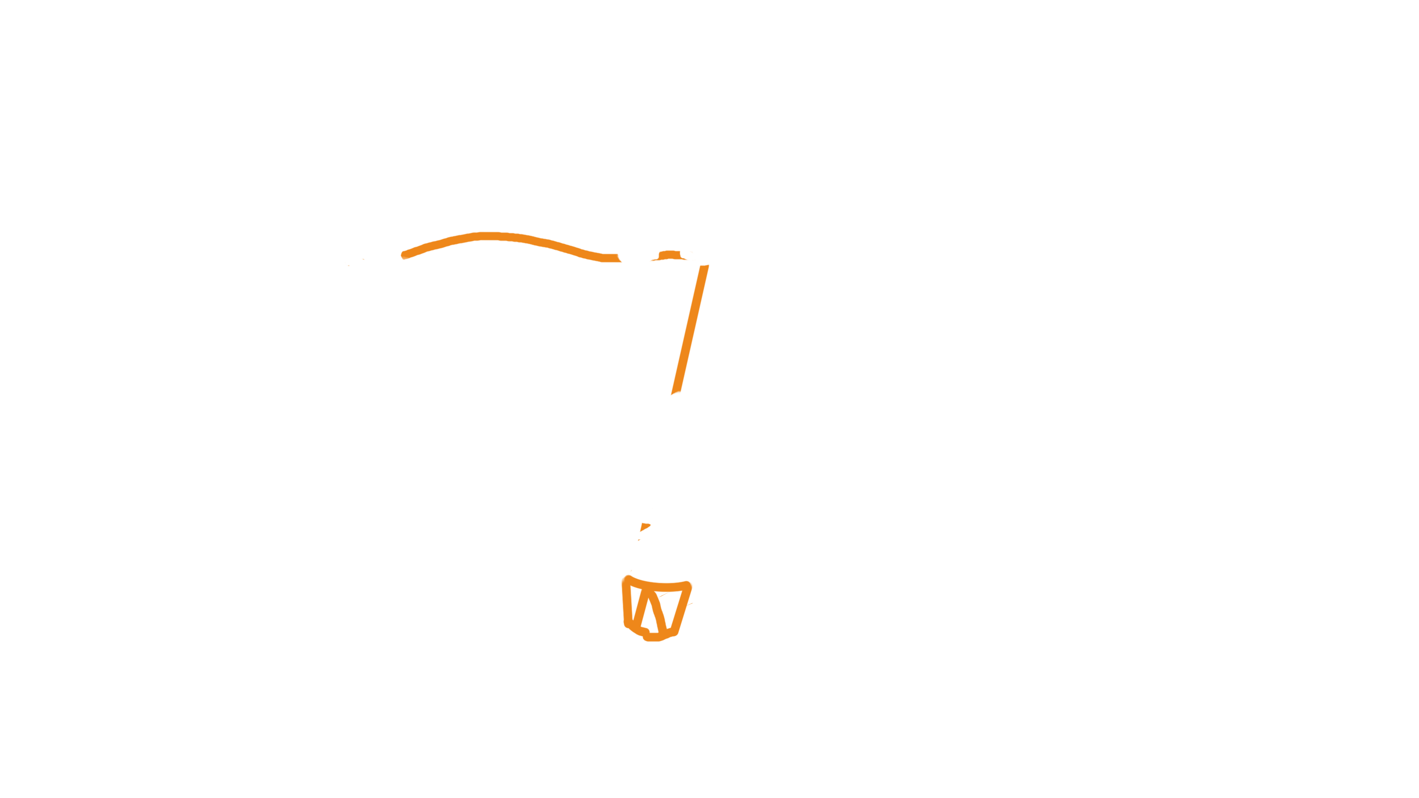
Andy stands on Suzy’s rope to prevent Suzy from falling.

Slide 17
See? Andy is standing on Suzy’s rope.

Slide 18
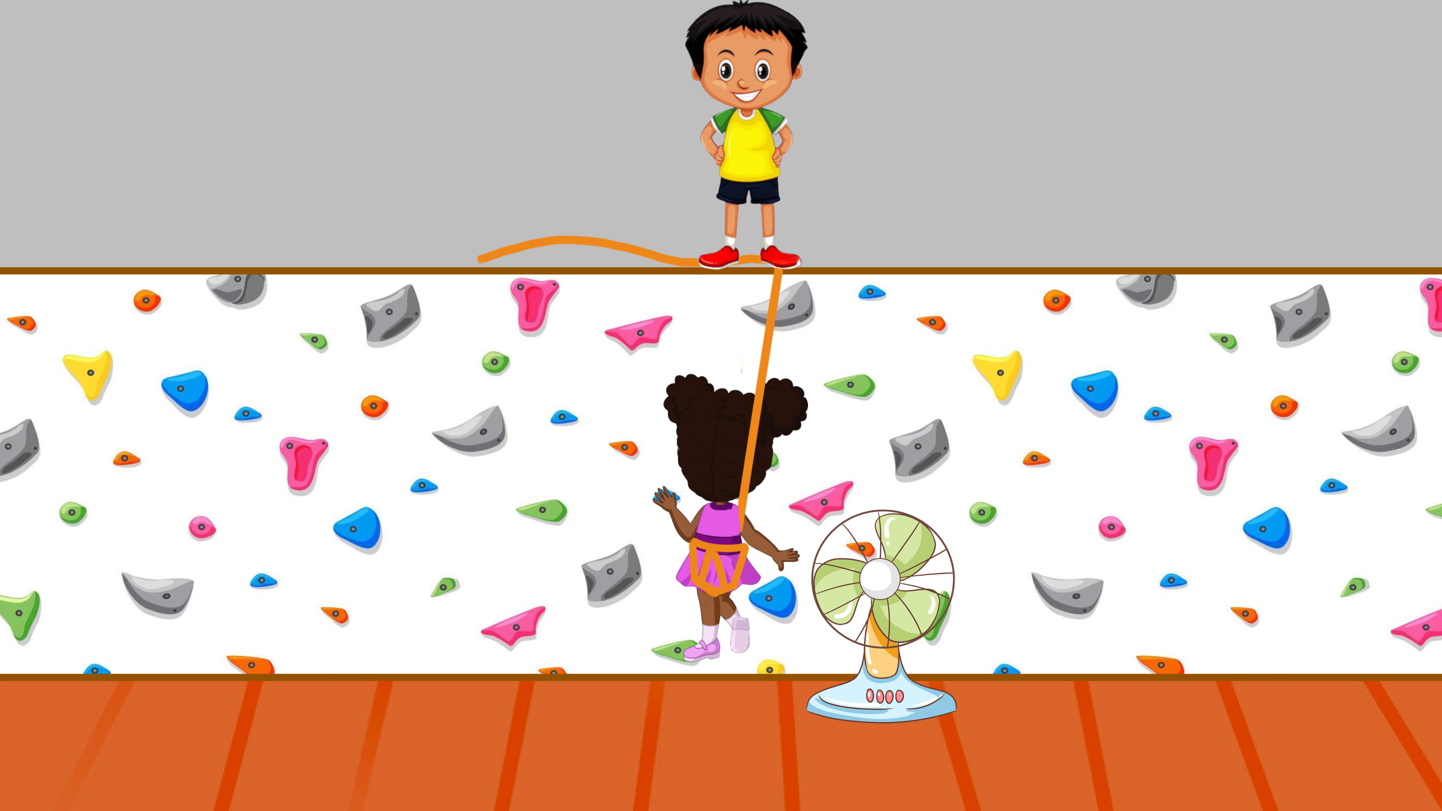
Suzy starts climbing up the wall.

Slide 19
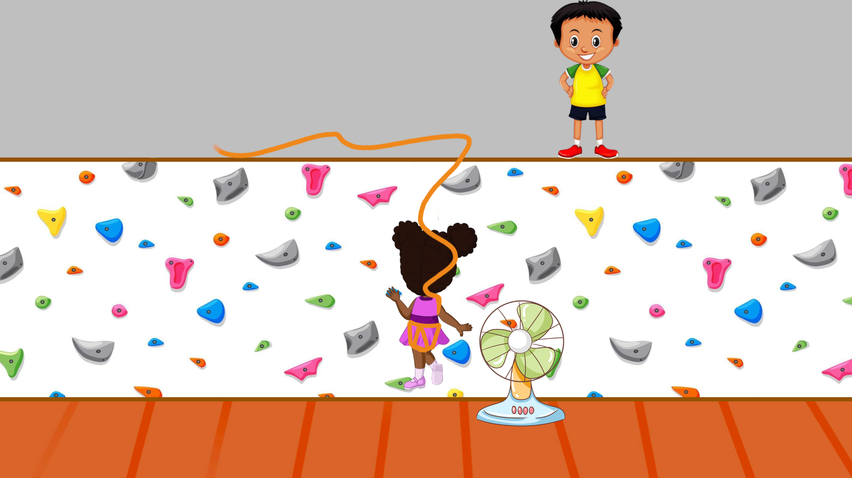
As Suzy is climbing, Andy wanders off.

Slide 20
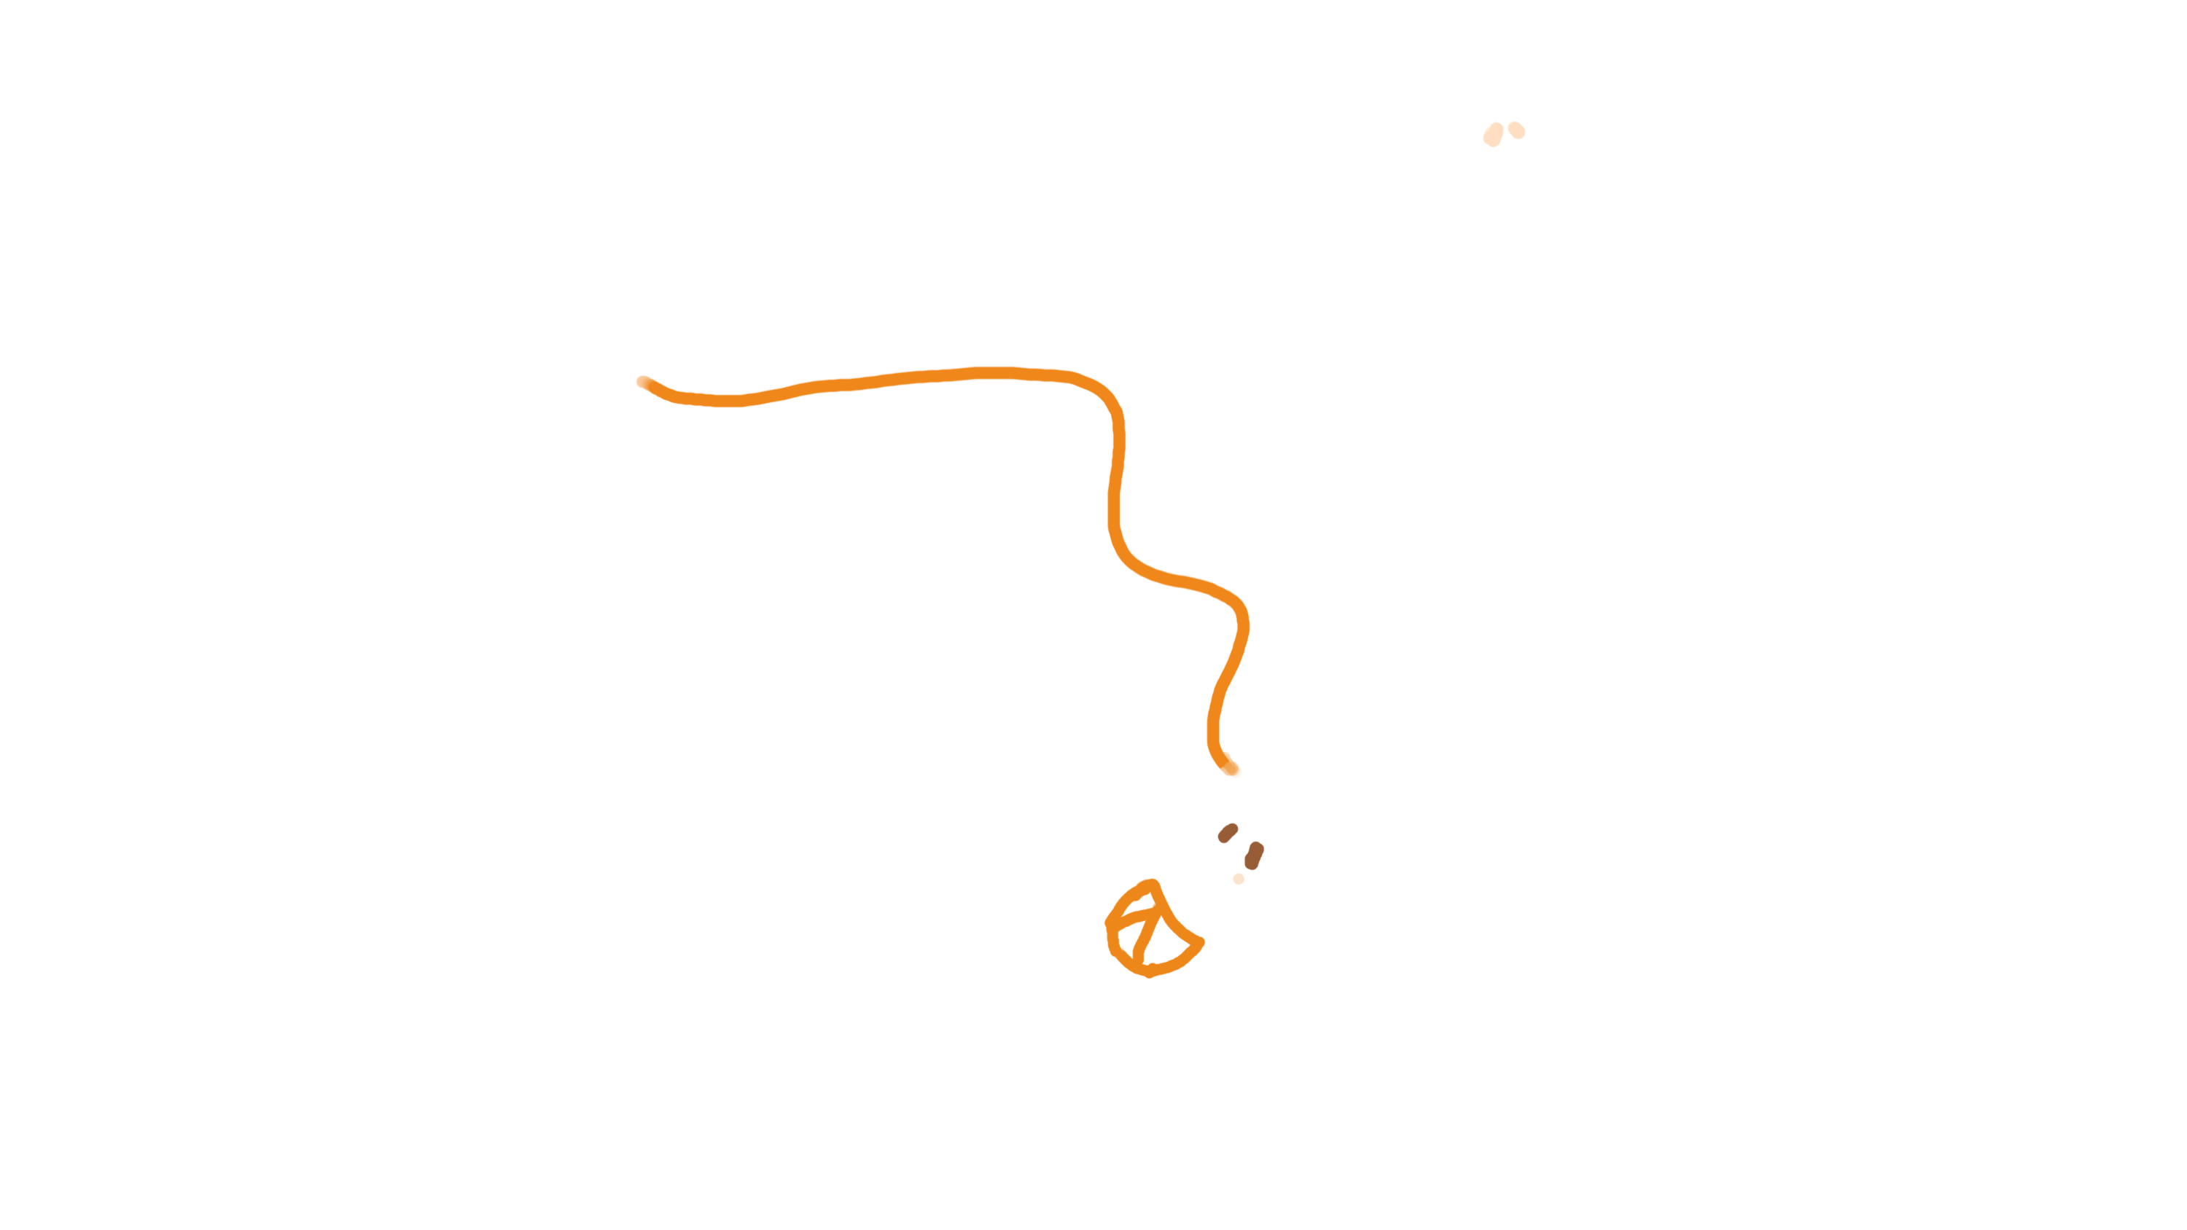
Suzy loses grip of the rock and falls.

Slide 21
Oh no Andy isn’t holding Suzy’s rope!

Slide 22

Suzy falls on the fan and it breaks.

Slide 23
Luckily, nobody got hurt – Suzy was OK.

Slide 24
Now that you saw what happened we would like to ask you a couple of questions.

Slide 25
Who broke the fan?

Slide 26
Who caused the fan to break?

Slide 27
Whose fault is it that the fan broke?

